Slide 1
FAST-Patch Study Recap

Slide 2
FAST-PFISR conjunction
Poor correlation between Ne and Je: Difference in preexisting Ne background?
Solution: select events with measurements of Ne background (Ne just equatorward of auroral ionization) and assume this background to be uniform within PFISR FOV
Difficulty in matching precipitation and Ne profile
Solution: require Ne profiles to exhibit latitudinal variations (e.g. from F region dominated to E region dominated) so that they can be matched to low to high energy precipitation.
Overall: from low to high latitude: Ne equatorward of oval → F region dominated Ne → E region dominated Ne (or both E and F contributed Ne)

Slide 3
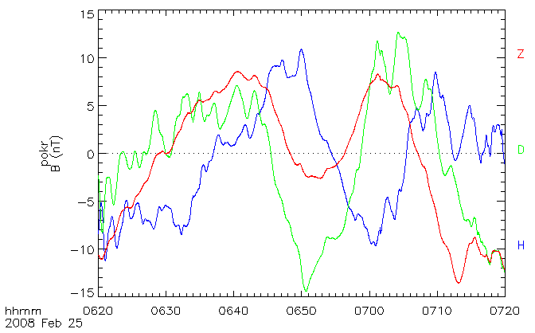
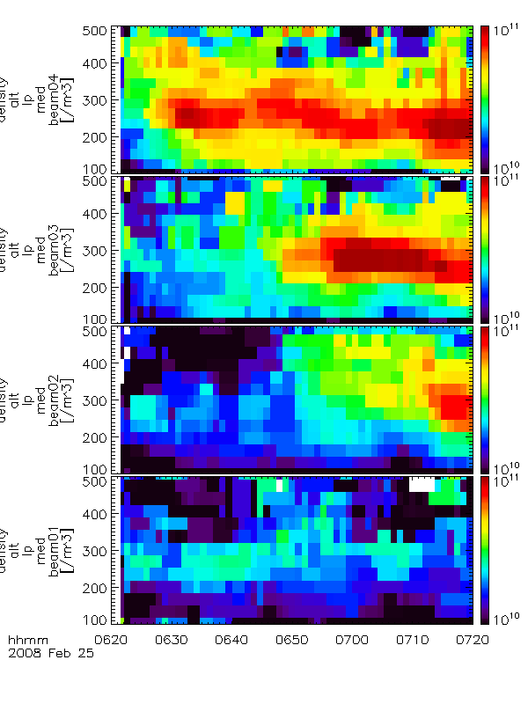
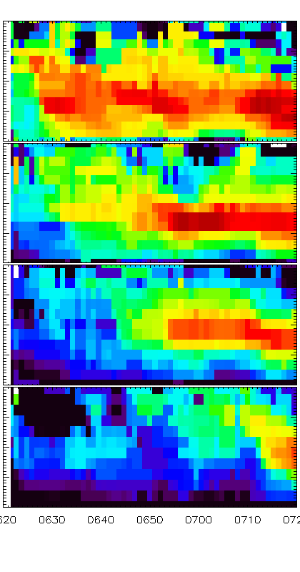
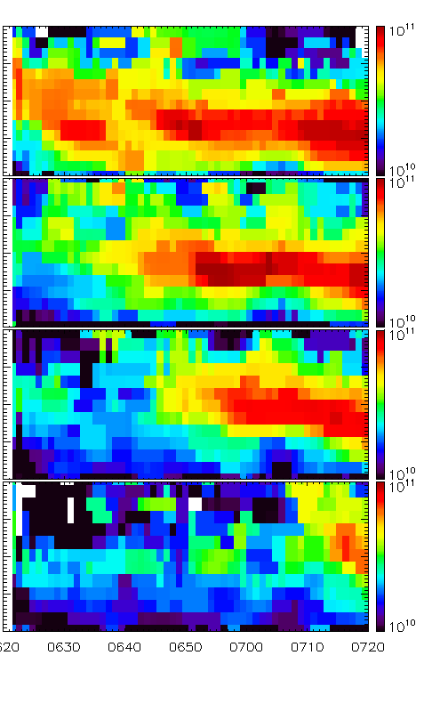

Slide 4
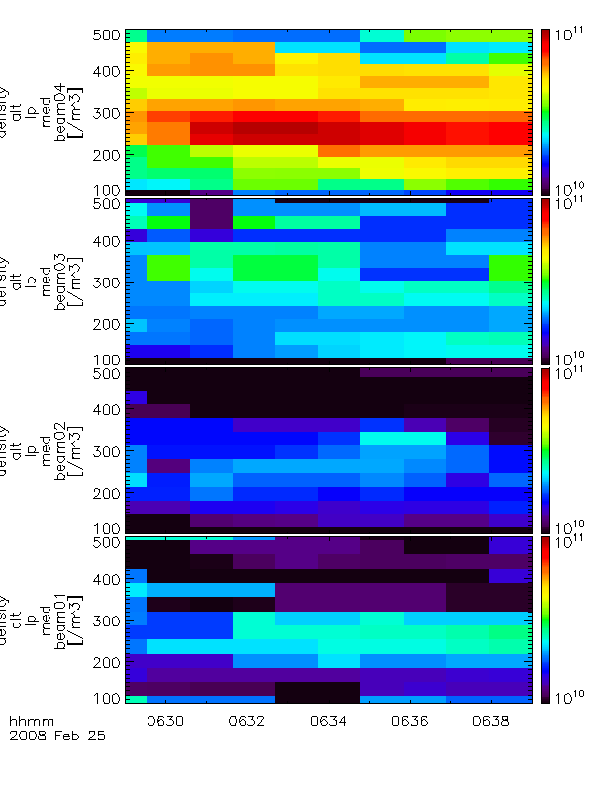
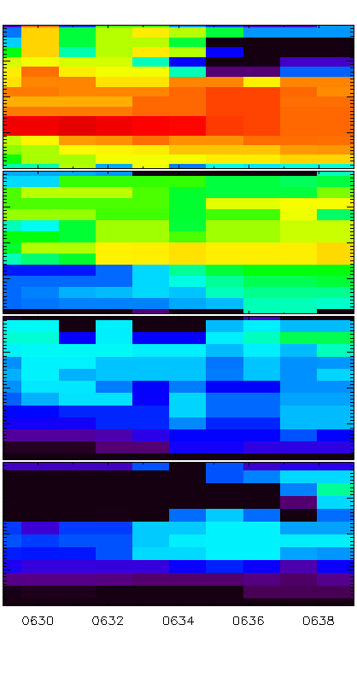
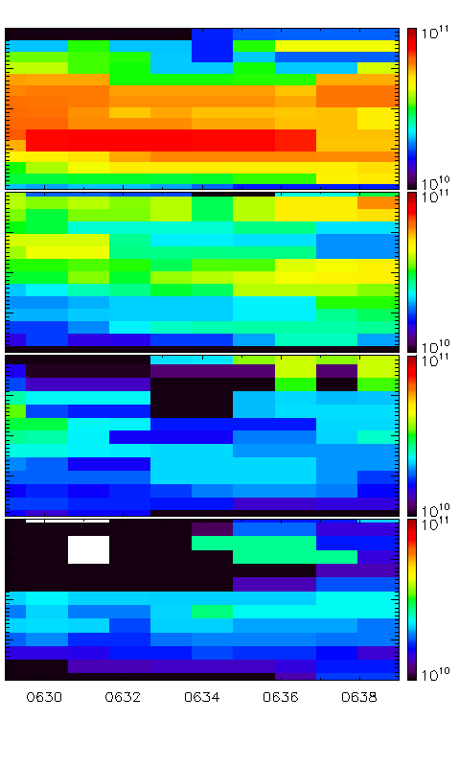

Slide 5
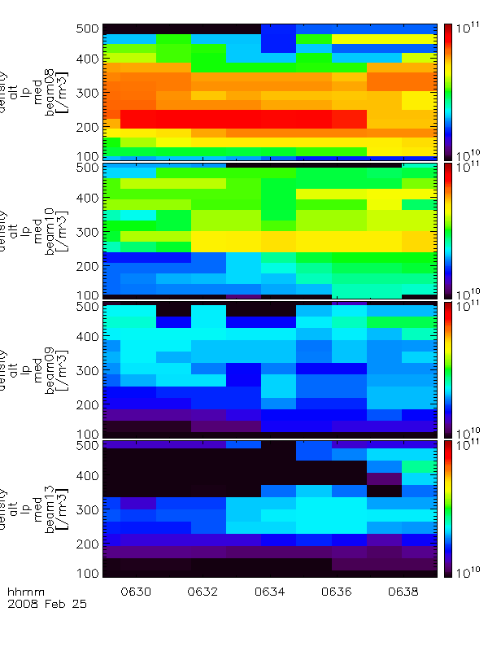
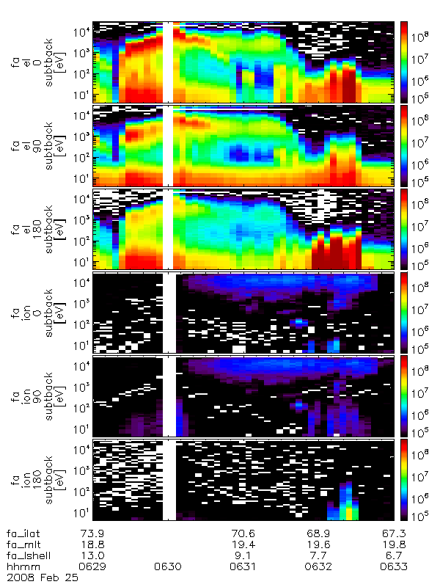
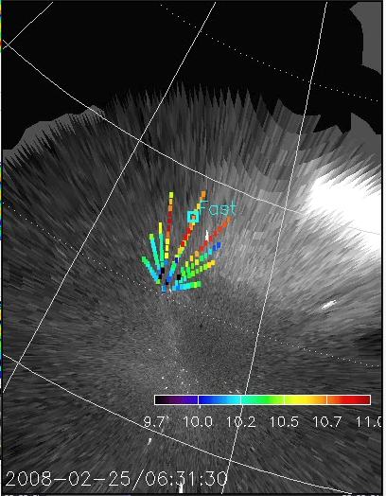
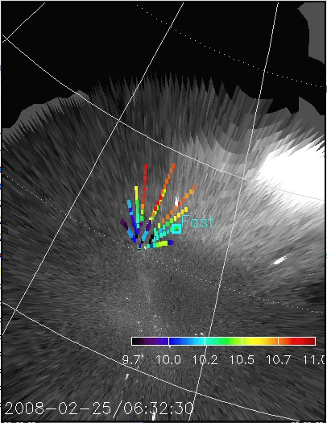
E+Low F region
High F region
Equatorward of oval

Slide 6
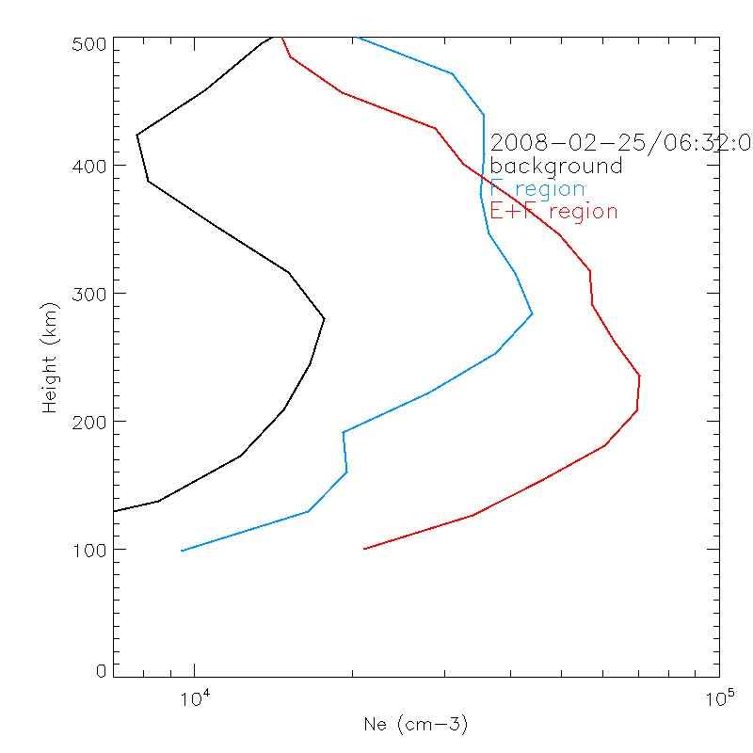
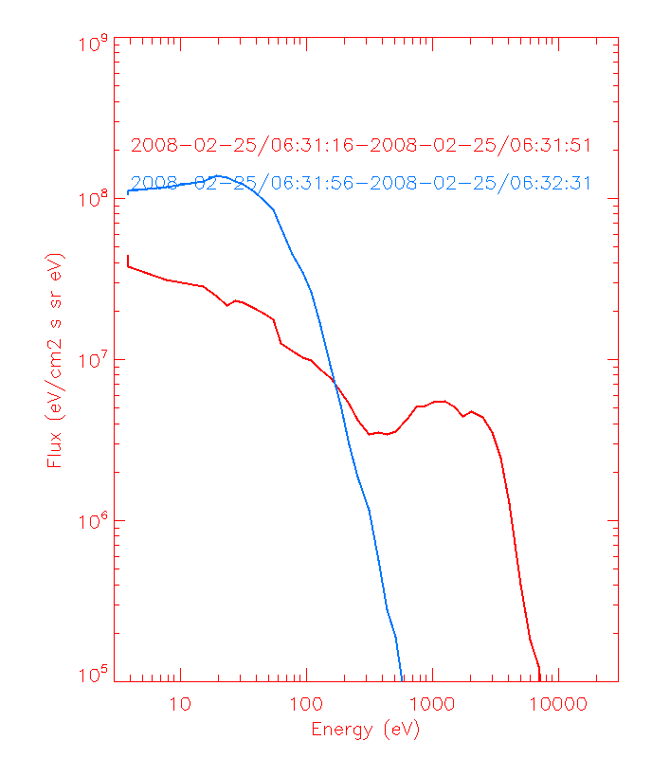

Slide 7
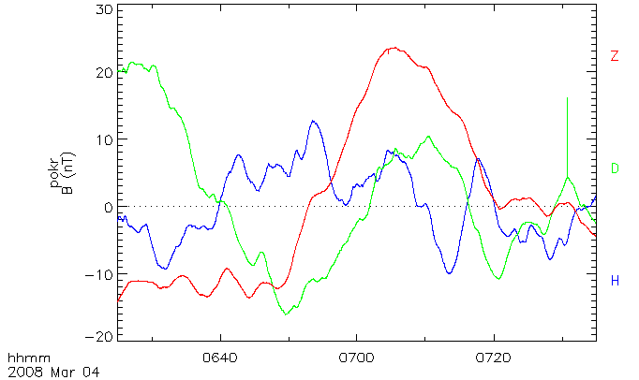
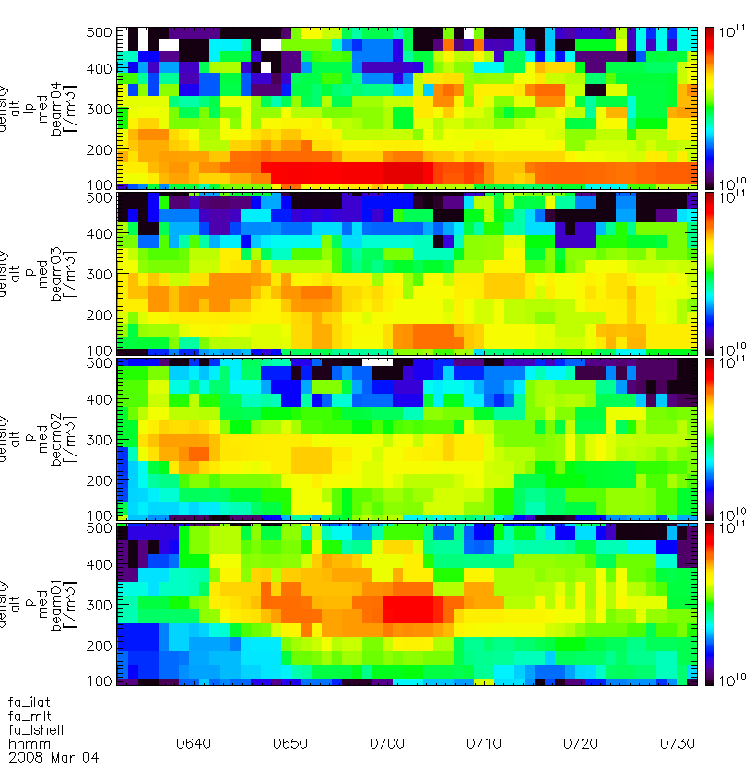
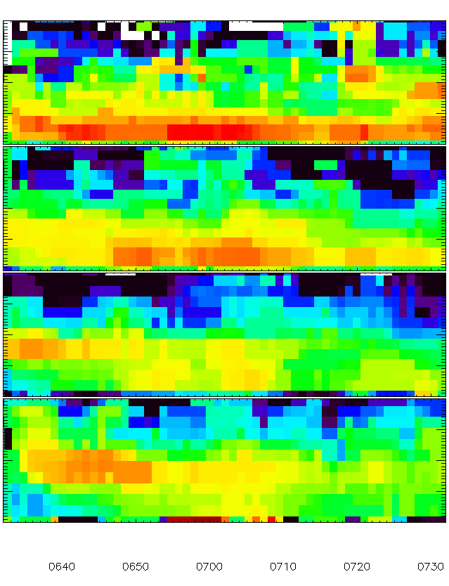
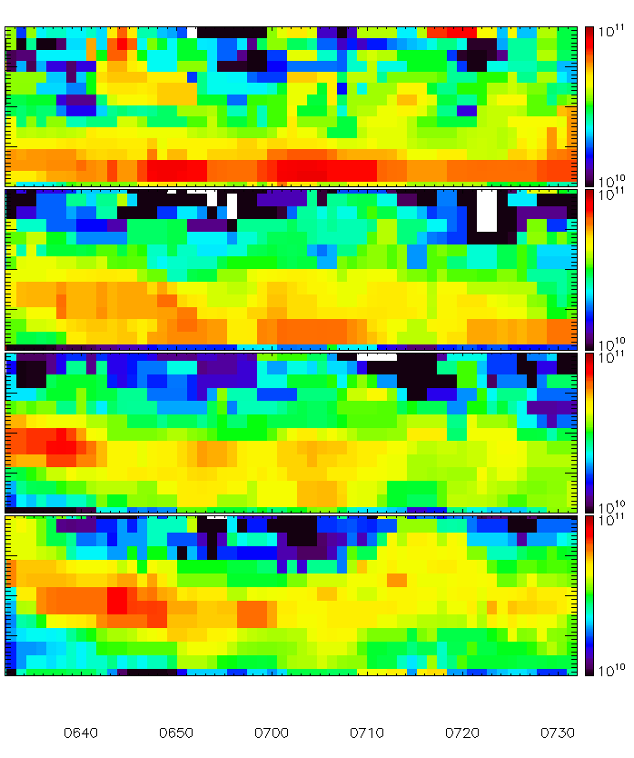

Slide 8
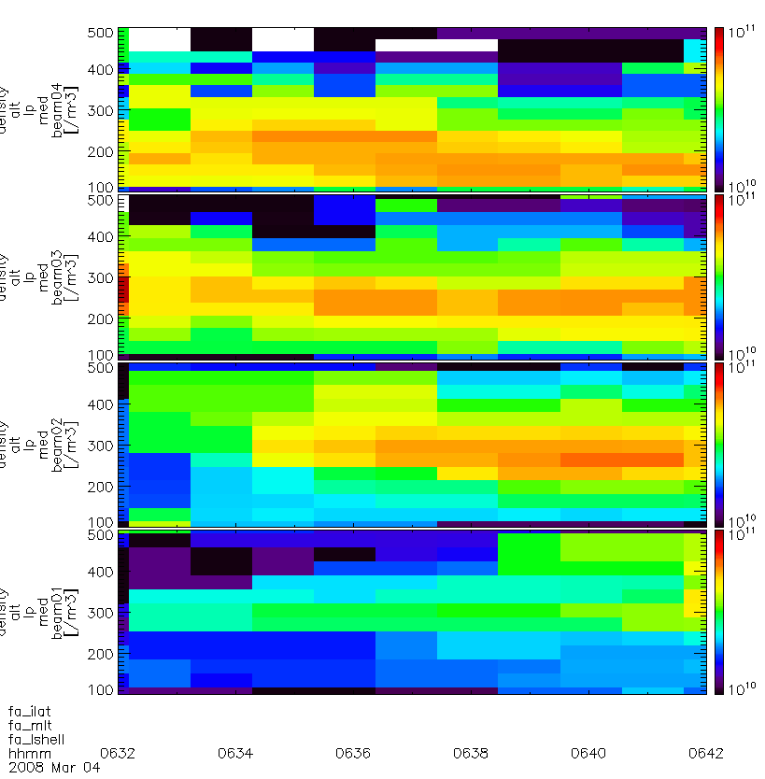
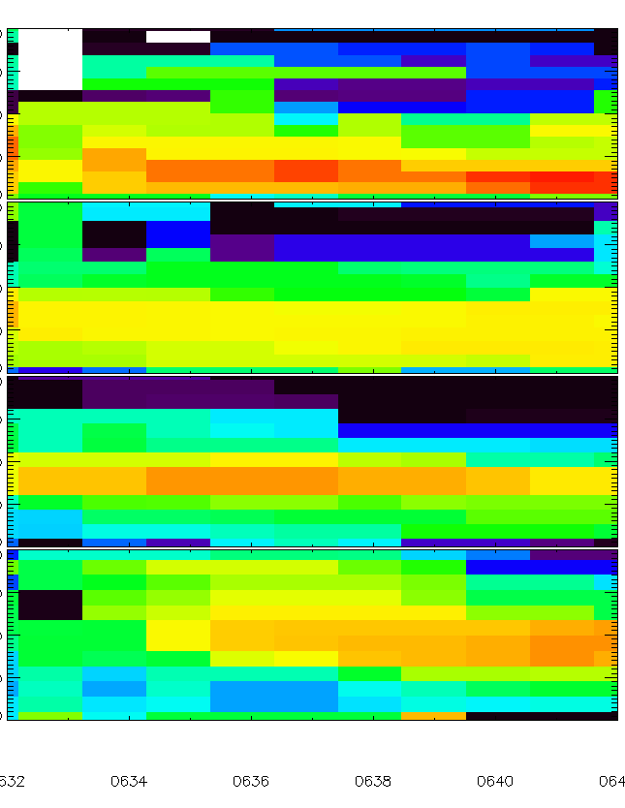
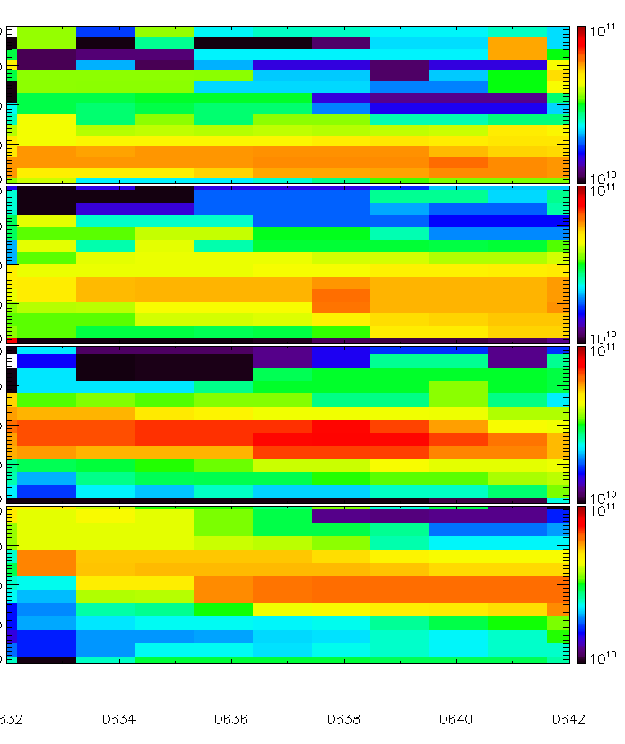
E region
F region
Equatorward of oval

Slide 9
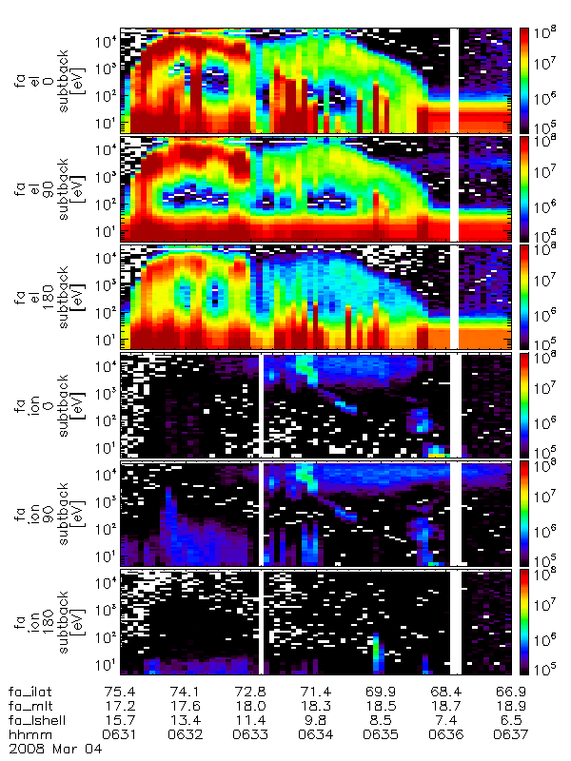
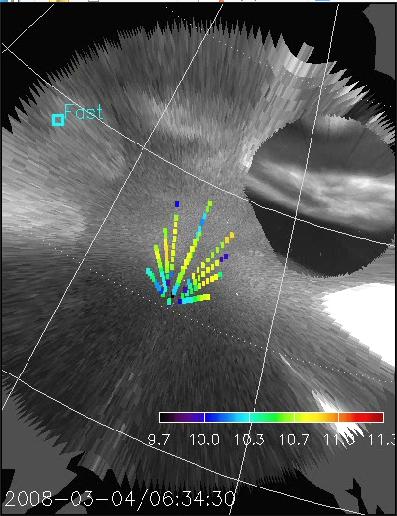
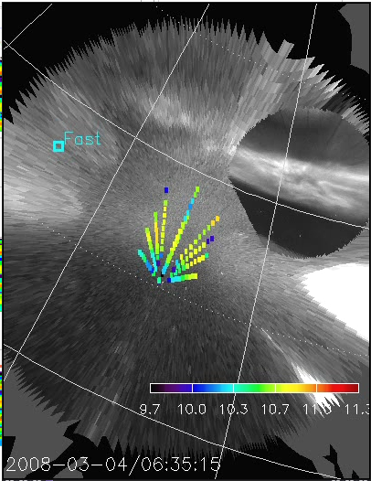
E region
F region
Equatorward of oval

Slide 10
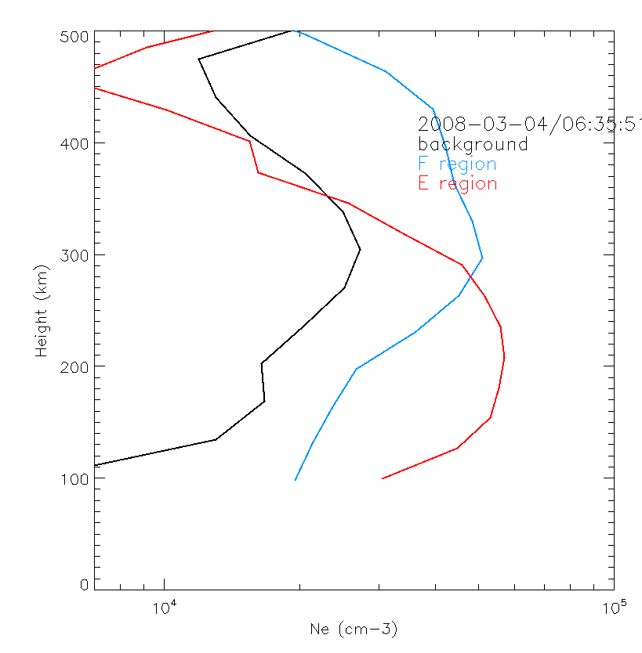
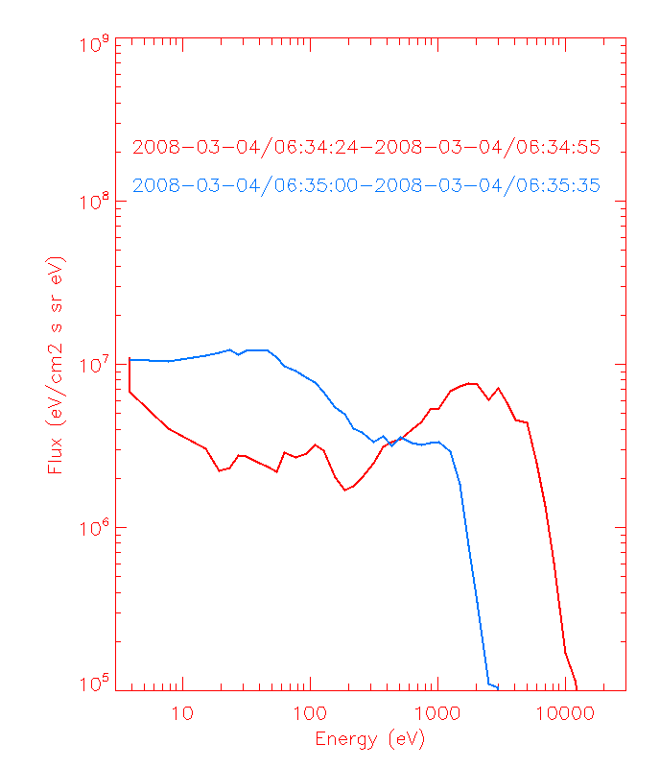

Slide 11
For airglow patch, J@100 eV ~ 3e6, i.e. F region ionization on the order of ~1e4
This is also consistent with Weber et al., 1996
~2.75e4
~3.9e4
~4e4
~2.35e4

Slide 12
Patch ionogram
Virtual height: change from height at peak dB to height that envelopes all points
Starting point of true height: change from 160 km to 200 km
Play with times

Slide 13
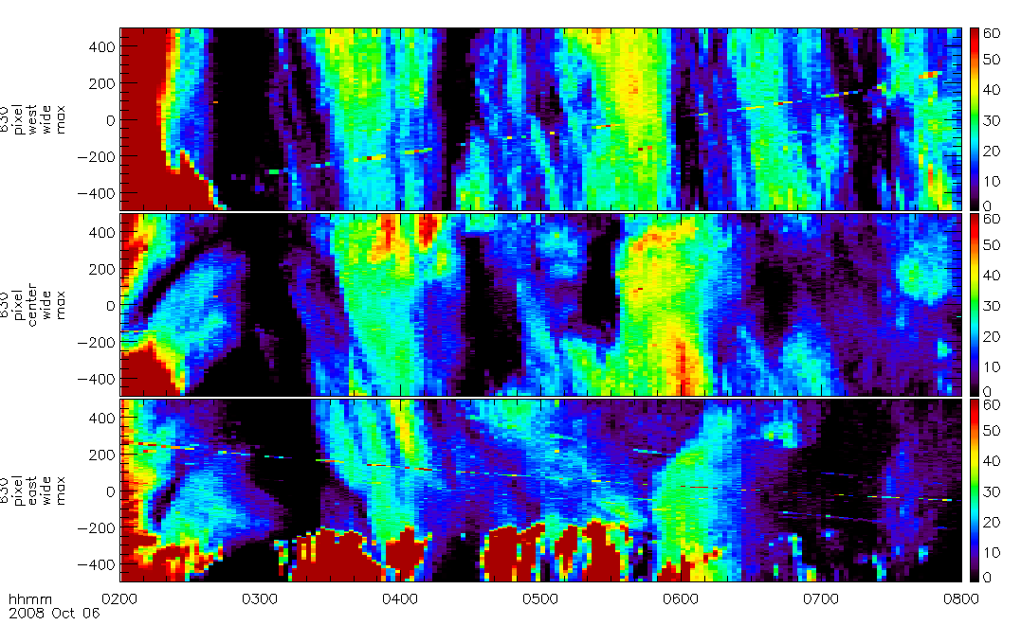
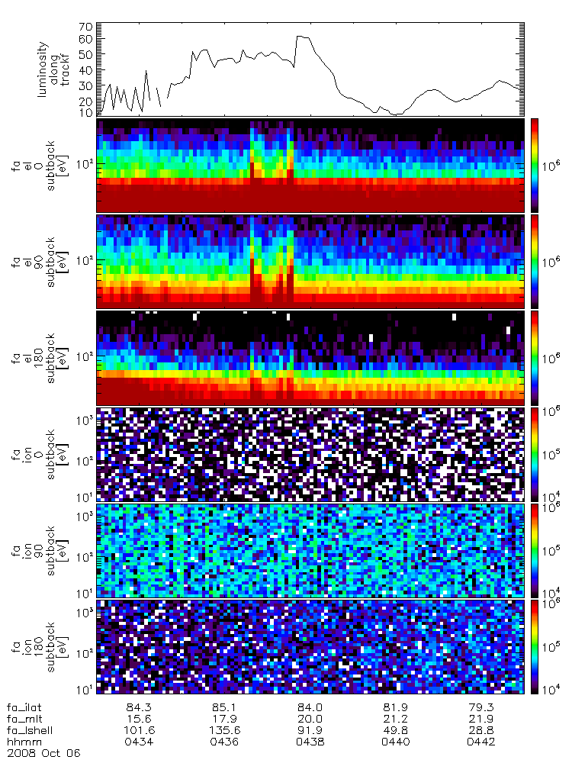
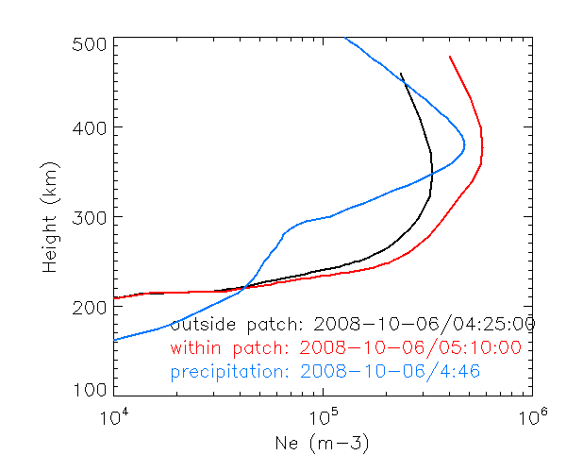

Slide 14
