Slide 1
Simulation Model
3-D hybrid simulation in GSE (ions are treated as particles and electrons as massless fluid).
Global scale in Cartesian coordinate system: both the dayside and night side magnetosphere system with x = -80 -- 20R_{E}, y = -30 -- 30R_{E}, and z = -30 -- 30R_{E}. An inner boundary has been assumed at the geocentric distance of r ≈ 3.5 R_{E}. In the Cartesian coordinate system used in the calculation, this boundary is a zig-zag Cartesian boundary approximating the spherical surface as in global MHD simulations.
Cold ion fluid in r<6.5R_{E}; fully kinetic ions outside.
n_{c}=1000/r³[1-tanh(r-6.5)]

Slide 2
The electric field can be obtained from the electron momentum equation*
where N=n_{c}+n_{p} is the total ion number density, Vi is the total ion bulk flow velocity, and pe is the electron pressure. Adiabatic or isothermal electrons are be assumed in the equation of state for the electron fluid.
The electron flow speed is calculated from Ampere’s law,
where the constant .
Quasi charge neutrality is assumed.
The magnetic field B is advanced in time from Faraday's law
* Swift[JCP, 109-121, 1996]

Slide 3

Boundary condition: (1) Sunward side: fixed; (2) All other side: free flow conditions are applied; (3) inner boundary: the ionospheric conditions is incorporated into the hybrid code, as in the global MHD models. The field‑aligned currents, calculated within the inner boundary, is mapped along the geomagnetic field lines into the ionosphere as input to the ionospheric potential equation.
The potential is then mapped back to the inner boundary of hybrid calculation where it is used as boundary condition for the flow and electric field.
Nonuniform, Cartesian cell grids are used, with a higher resolution (≈0.1R_{E}) around the interesting regions of the near-Earth plasma sheet. The grid size is approximately proportional to local ion initial length. Cell dimensions are N_{x}×N_{y}×N_{z} ≈ 320×220×220.
A typical time step is Δt = 0.05Ω₀⁻¹. For a small percentage of highly energetic particles, the splitting-particle method can be adopted to improve the counting statistics in the energetic tail of the resulting distributions. Sub-time steps can also be applied to particles moving into the strong magnetic field region near the Earth.

Slide 4
Case 1:
IMF: Purely Southward B=(0,0,-10nT)
Solar wind n=6cm⁻³, v=700km/s, T_{i}=10eV
M_{A}=7.8,β=0.25
Ionospheric conductance Σ_{P}=5mhos, Σ_{H}=0
[Lin et al., JGR, 2014; Lu et al.,PoP, 2015; JGR, 2015]

Slide 5
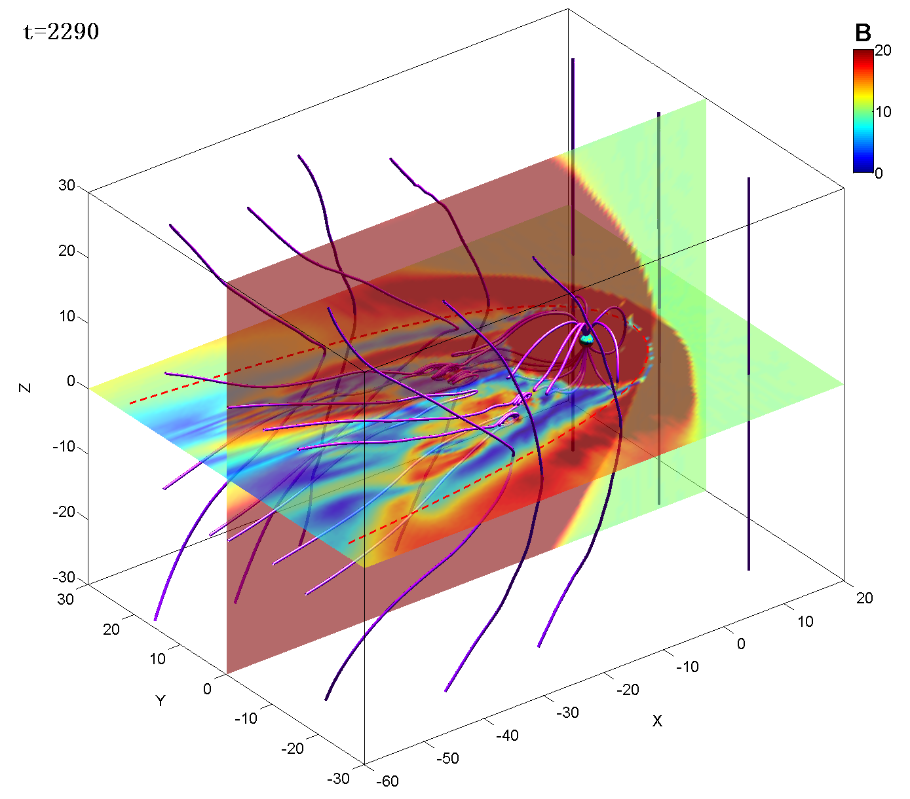
3-D global view of field lines and contours of B at t=2290s showing multiple flux ropes in the near-tail plasma sheet.

Slide 6
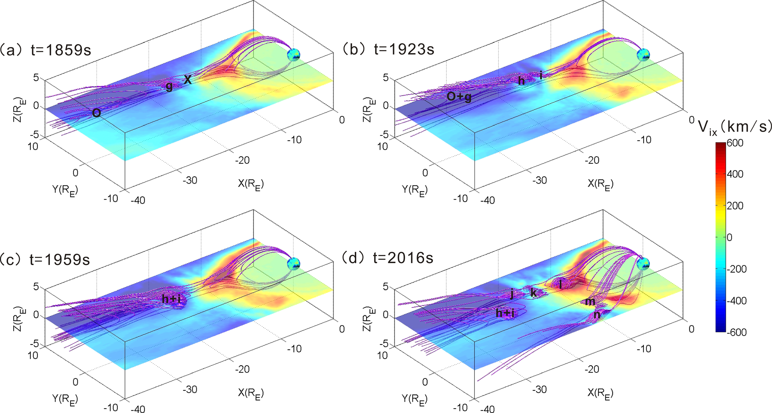
Reconnection flux ropes and fast flows
primary X line
more flux ropes
secondary flux rope
merged
coalesced flux ropes

Slide 7
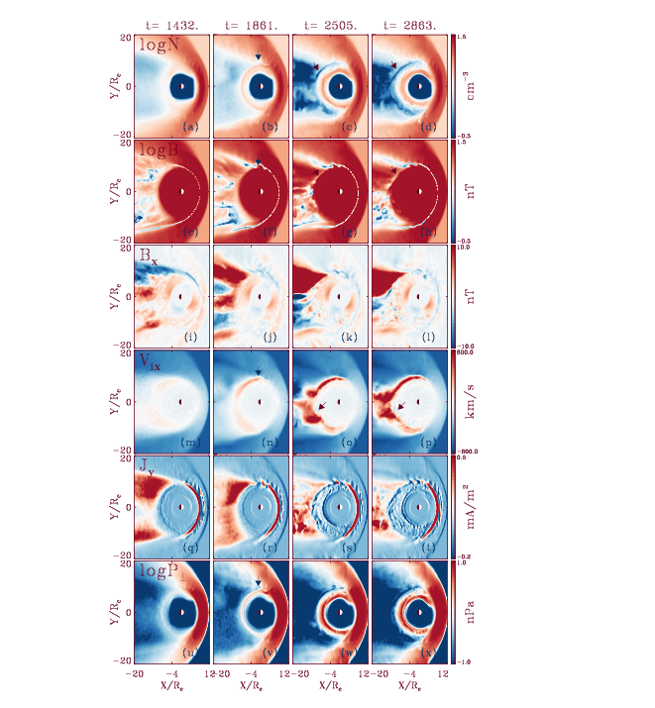
Dynamic evolution
of near-tail plasma
sheet (z = 0)
Global dipolarization
and ion injection

Slide 8
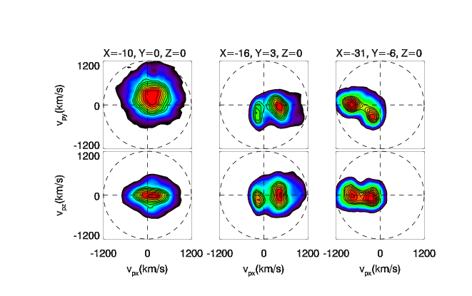
Ion velocity distribution and ion beams
tailward of X line: tailward jet
Earthward of X line: Earthward jet

Slide 9
Case 2:
IMF: Purely Northward

Slide 10
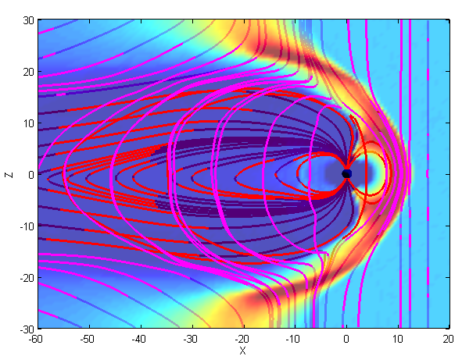
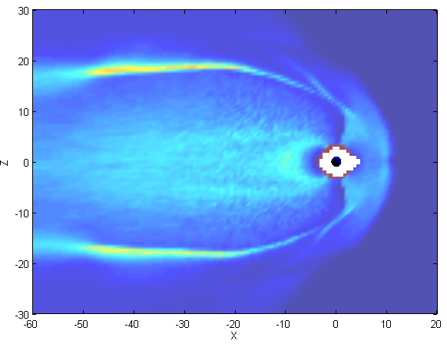
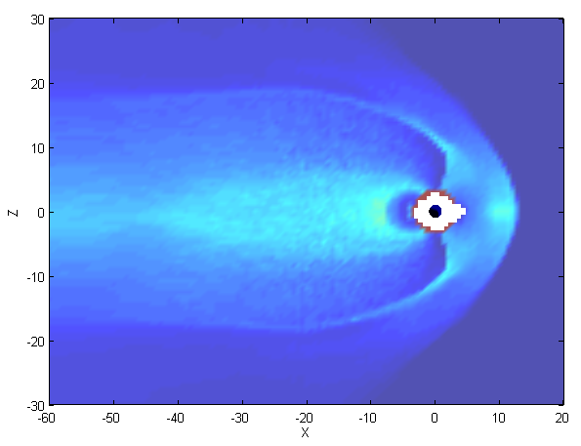
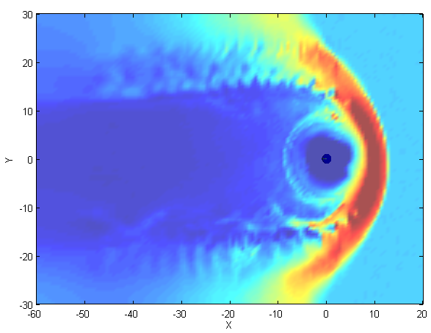
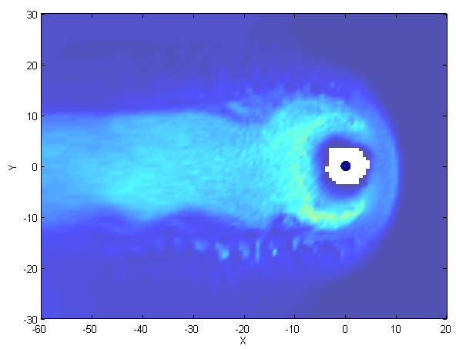
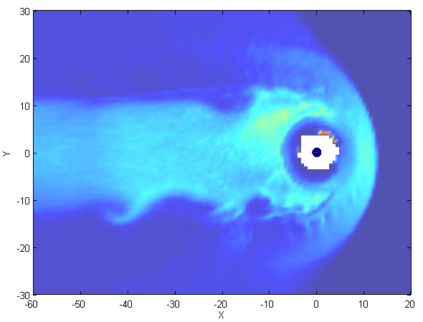
Structures in the meridian and equatorial plane
t=2450s
N
T||
T⊥
t=2450s
N
T||
T⊥

Slide 11
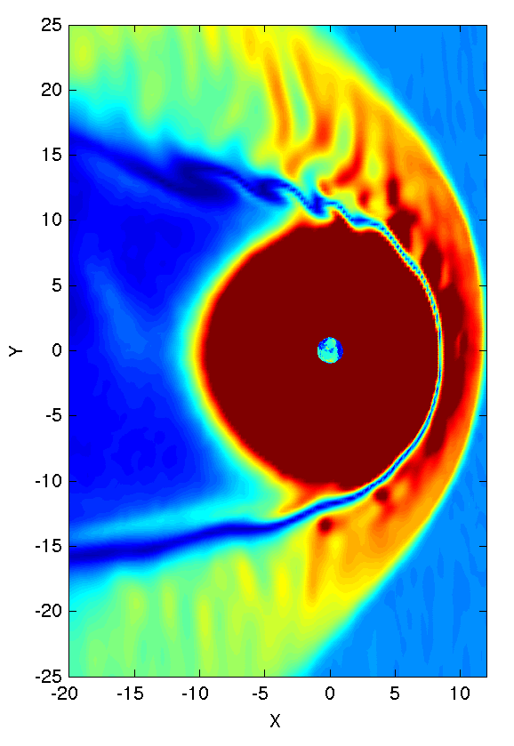
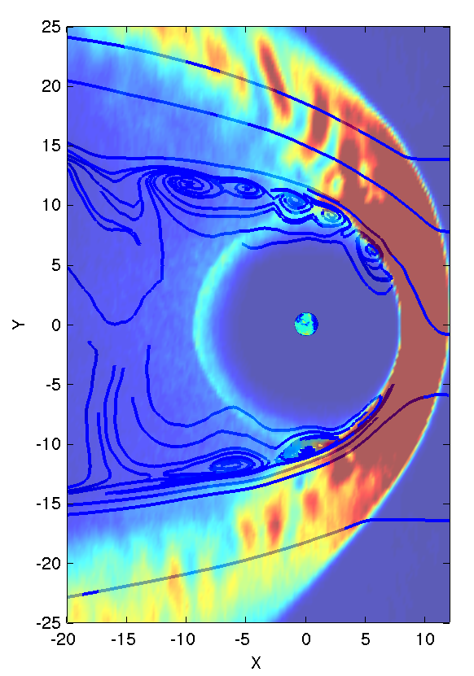
Vortex at the magnetopause boundary layer
(a)
(b)
Contours of (a) magnetic field strength and (b) total ion pressure in the equator.

Slide 12
Case 3:
IMF: Northward B=(0,-3,-3)nT
Dipole tilt angle = 15°

Slide 13
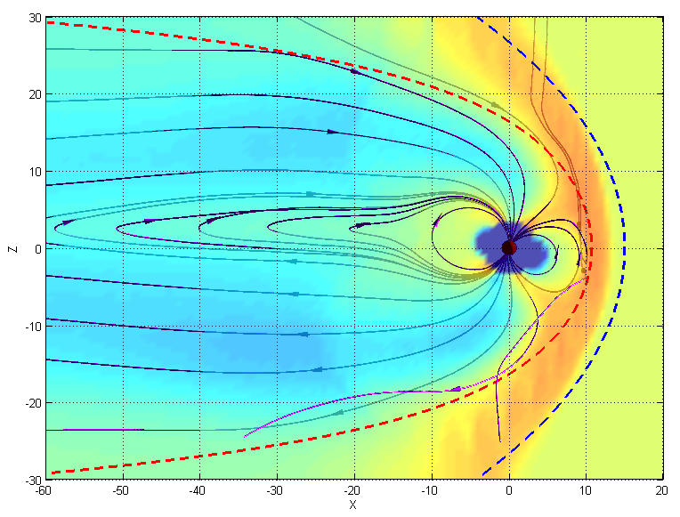

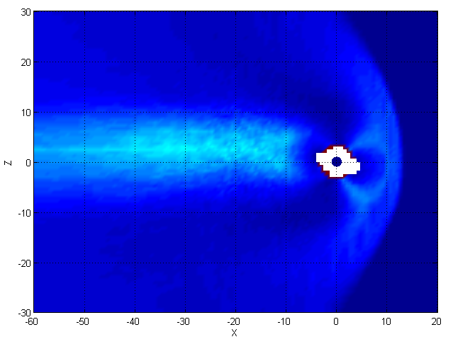
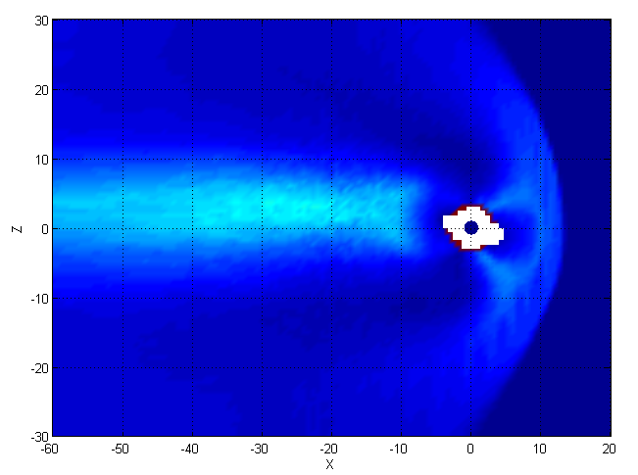
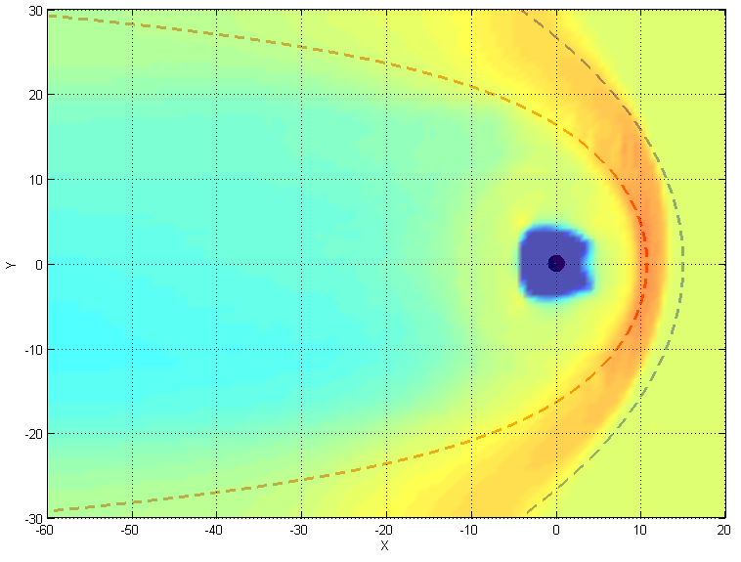
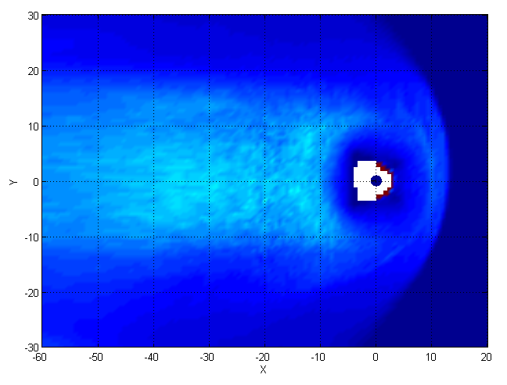
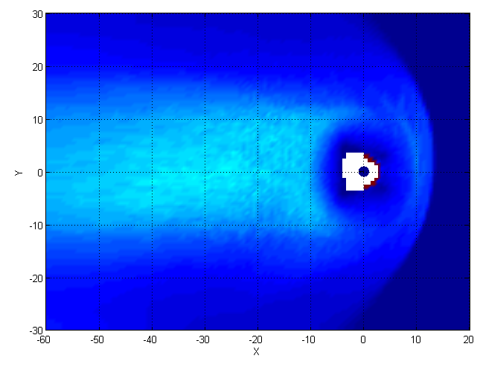
Spatial profiles of ion density and ion temperatures
t=1890s
Log(N)
T||
T⊥
Contours of ion density, temperatures in the noon-midnight meridian plane
t=1890s
Log(N)
T||
T⊥
Contours of ion density, temperatures in the plasma sheet at z=1R_{E}

Slide 14
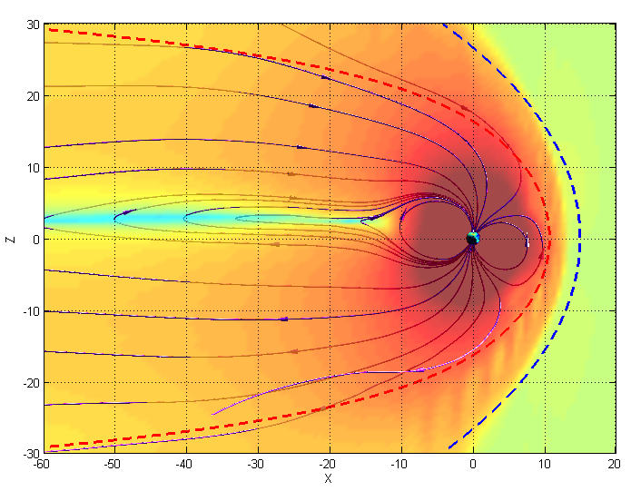
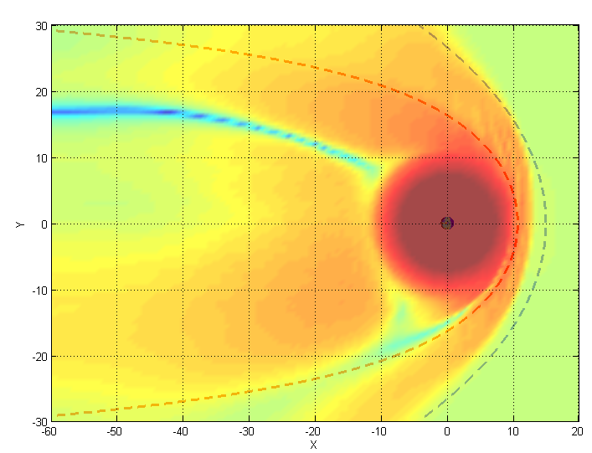
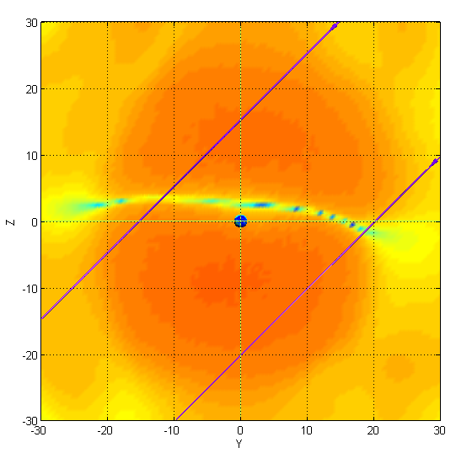

Magnetic field strength at different cross section
t=2540s
log(B)
log(B)
Y=0
z=1
Chao et al. model
log(B)
x=-20
IMF

Slide 15
Case 4:
Event of 140213 5-6.5UT
What is the initial condition?

Slide 17
