Slide 1
ARTEMIS Observations vs MHD Simulations for A Shocked Magnetotail at 60 Re
Xiaoyan Zhou, Xu-Zhi Zhou, Vassilis Angelopoulos, Joachim Raeder, Denny M. Oliveira

Slide 2
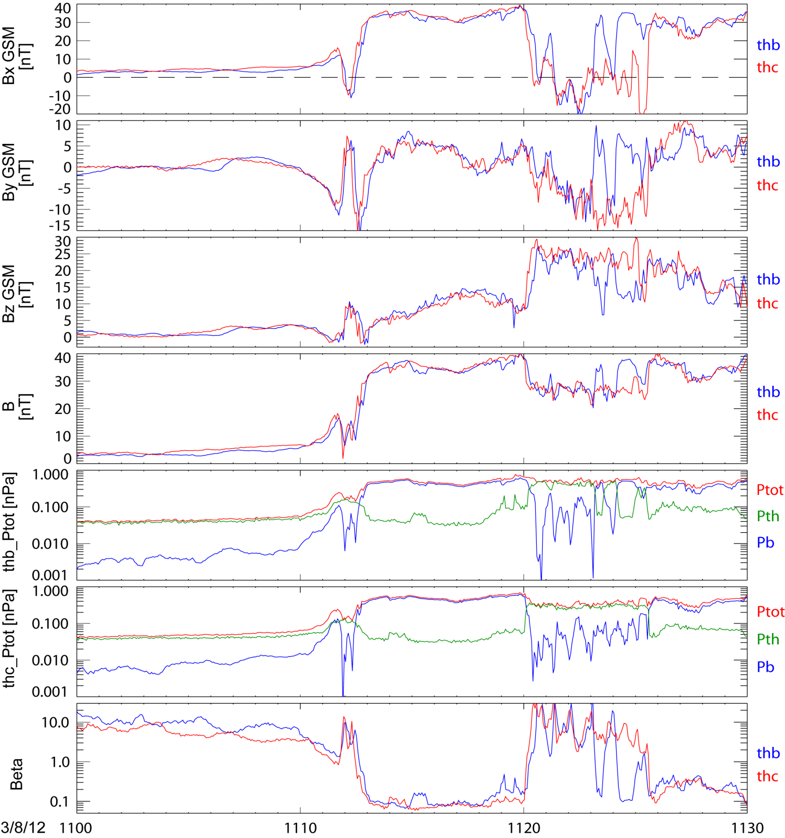
t1
t2
t3
Y(GSM) | Z(GSM)
THB 1.3 Re | -5.2 Re
THC 1.5 Re | -4.4 Re
Top to bottom: Bx, By, Bz, B, Ptot and Beta at THB and THC.
Internal compressional waves arrived at t1, ~1103:50UT, when a gradual compression seen by THC. The propagation speed was ~2000 km/s.
The external shock arrived at t2, ~1111 UT, when the magnetic field started abruptly increasing.
t3 marks the end of the compression.
Focusing on the shading interval when there were CS crossings shown by all parameters.

Slide 3
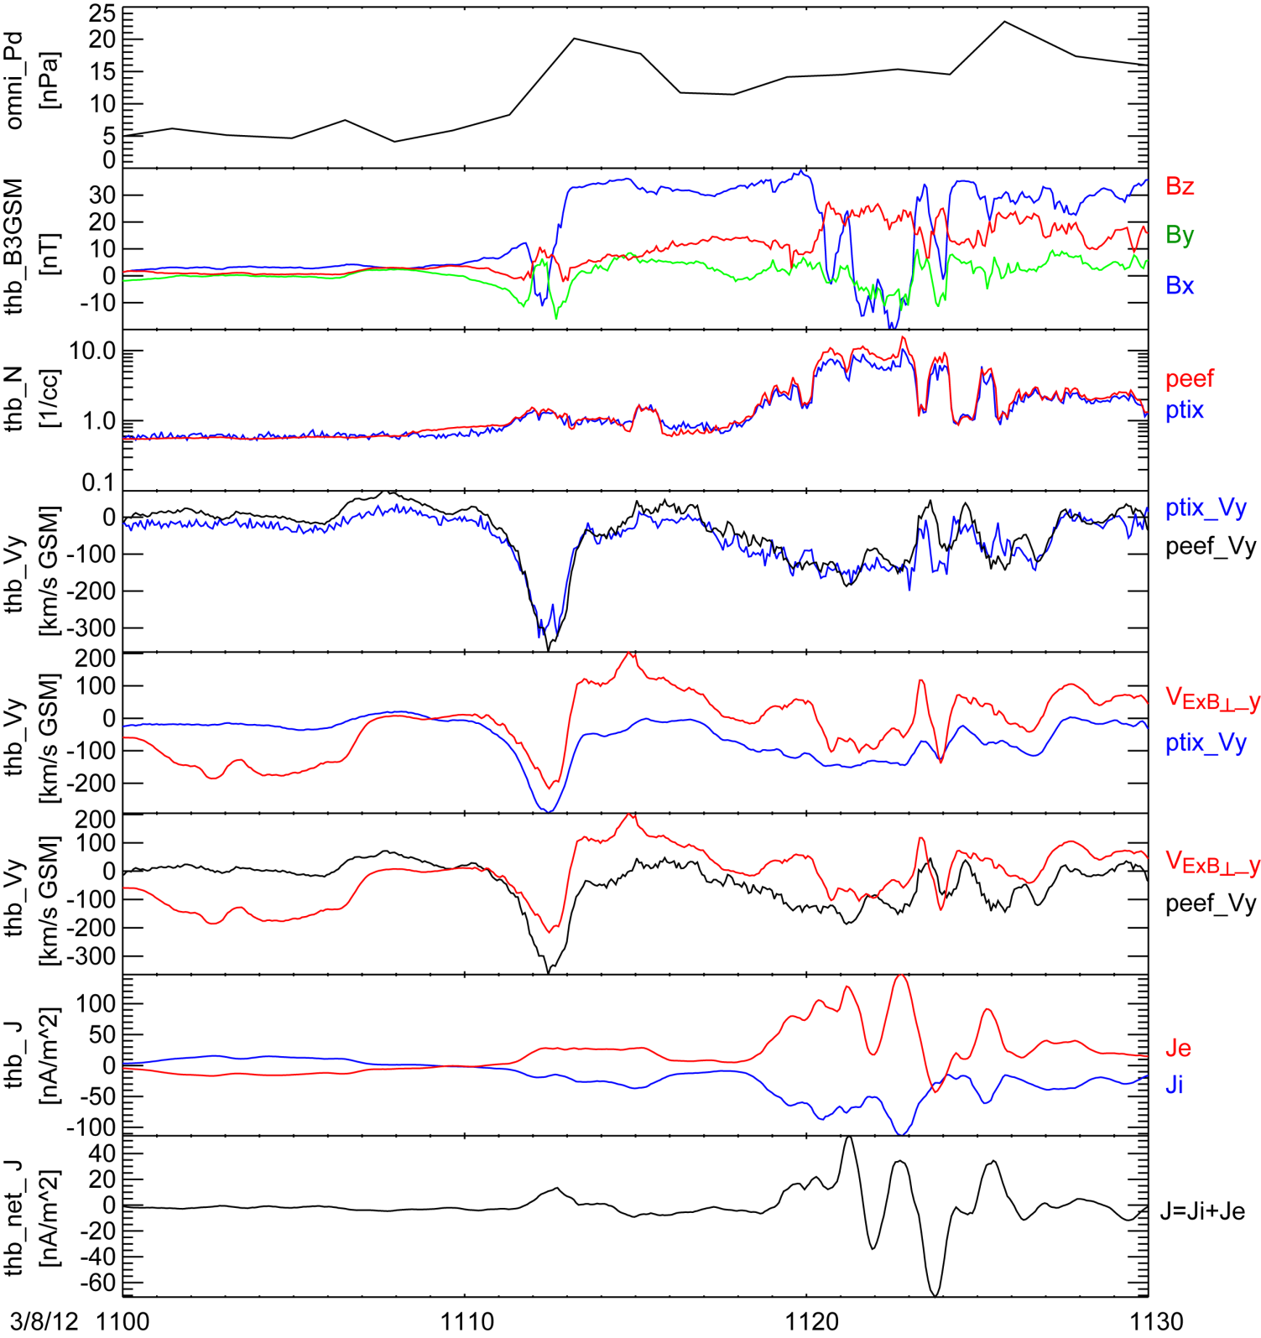
t1
t2
t3
Solar wind dynamic pressure, Pd, shifted to -60Re
Tail magnetic field components in GSM at THB
THB proton (ESA+SST) and electron (ESA) density comparison
Proton (ESA+SST) and electron (ESA) velocities at THB
Comparison proton velocity and ExB drift in GSM-Y.
VDi = Viy – VExB_perp_y
Comparison electron velocity and ExB drift in GSM-Y.
VDe = Vey – VExB_perp_y
Comparison proton and electron diamagnetic current density.
Net diamagnetic current density, showing an sudden increase of ~40 nA/m^2 in ~90 sec at 1112 UT. ~37% from electrons.

Slide 4
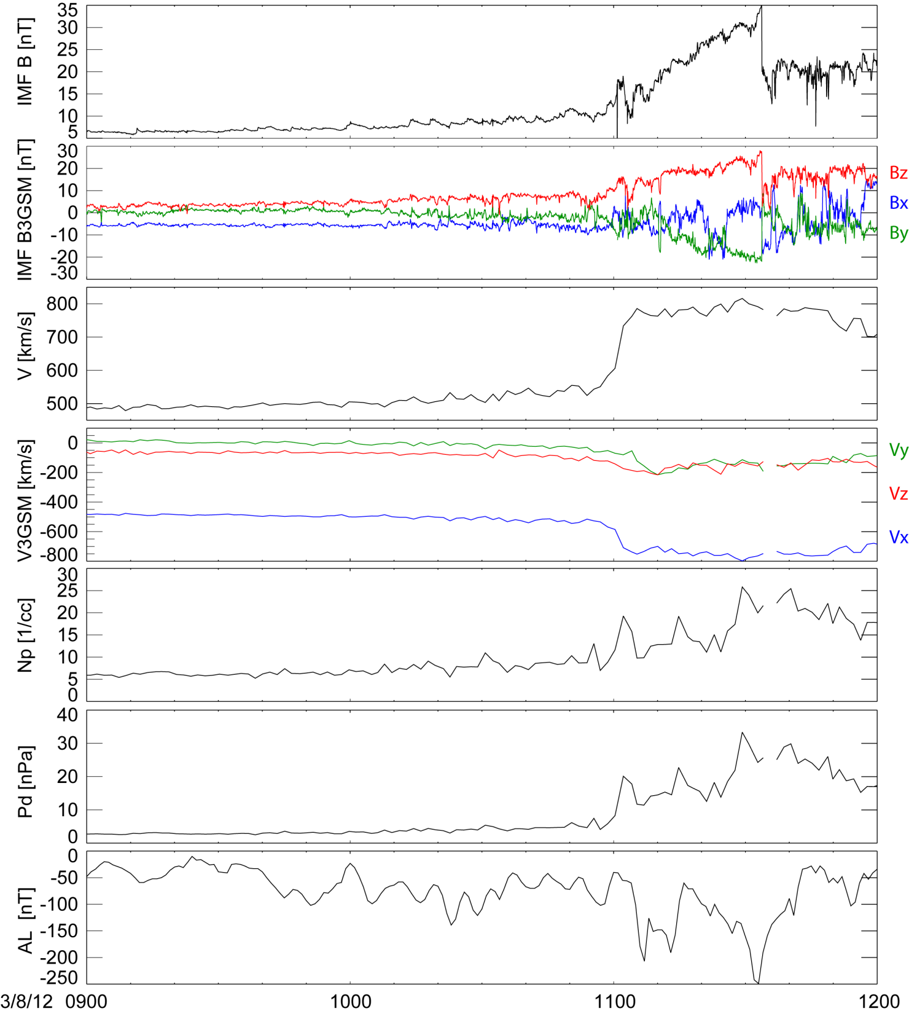
Wind observations on 3/8/2012
shock
SC at 1100 UT
The solar wind data are shifted ~30 min to the sub-solar magnetopause assuming to be 10 Re.
<Bz> = 5.0 nT 2 hr upstream of the shock. So there is no auroral substorm activity.
IMF turned to further north at the shock.
The solar wind velocity jumped from ~500 to 800 km/s,
Vy turned to further dawnward from -50 to -200 km/s,
the ram pressure increased from ~4 to 20 nPa and. Tp was ~7 eV upstream and increased to ~13 eV (not shown here).
AL reduced to -200 nT from -40 nT, but increase in AU is more abruptly from ~100 to 350 nT (not shown here).

Slide 6
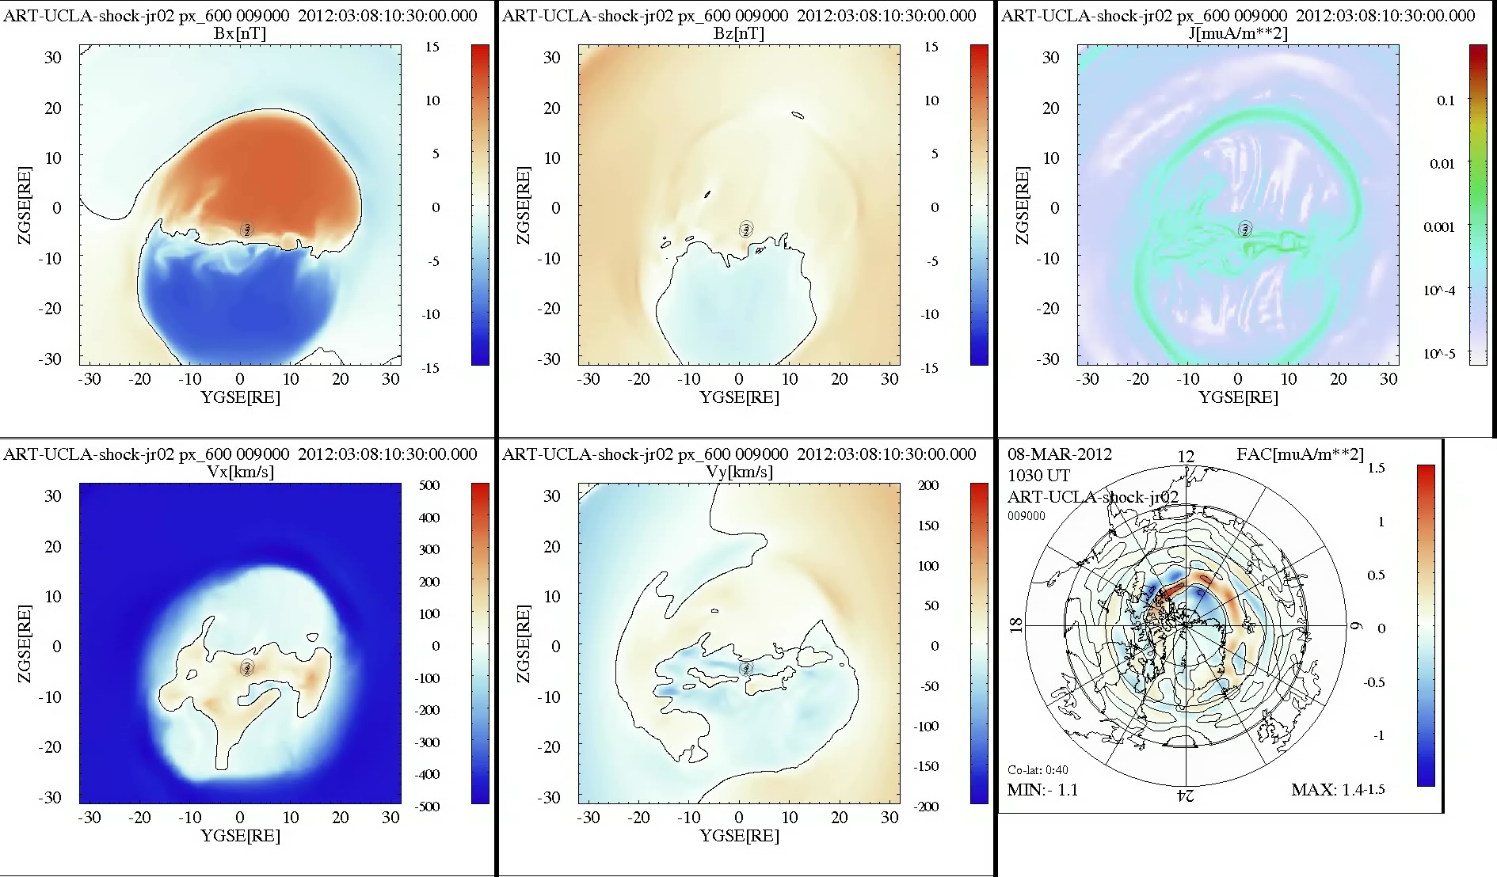

Slide 7
Link for other movies on this event:
http://mhd.sr.unh.edu/~jraeder/publicfiles/XiaoyanZhou/

